Slide 1
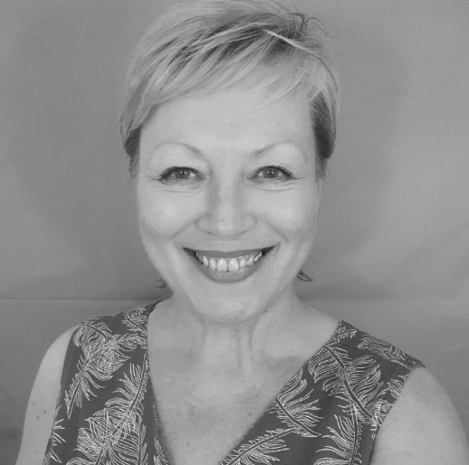


IoSCM
Conference
& Exhibition
WORKSHOP
12:15 – 13:15
No-nonsense Stress-Busting
The ‘No-nonsense Stress-Busting’ workshop will give you a unique spin on techniques and strategies to help tackle the stresses of life, work and dealing with difficult people.
Gillian Fortune,
The Feel Good Community
Copthorne Hotel
Newcastle
20th October 2022

Slide 2
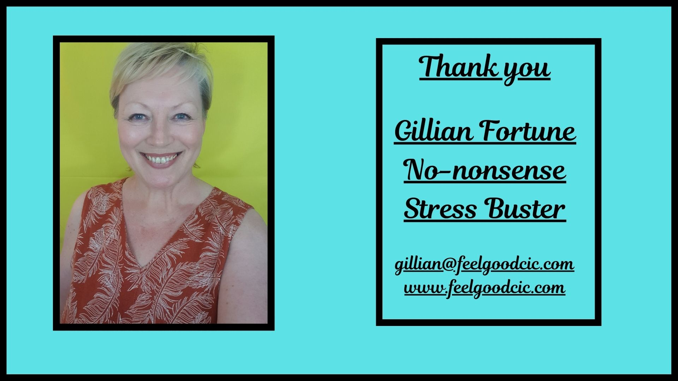

Slide 3
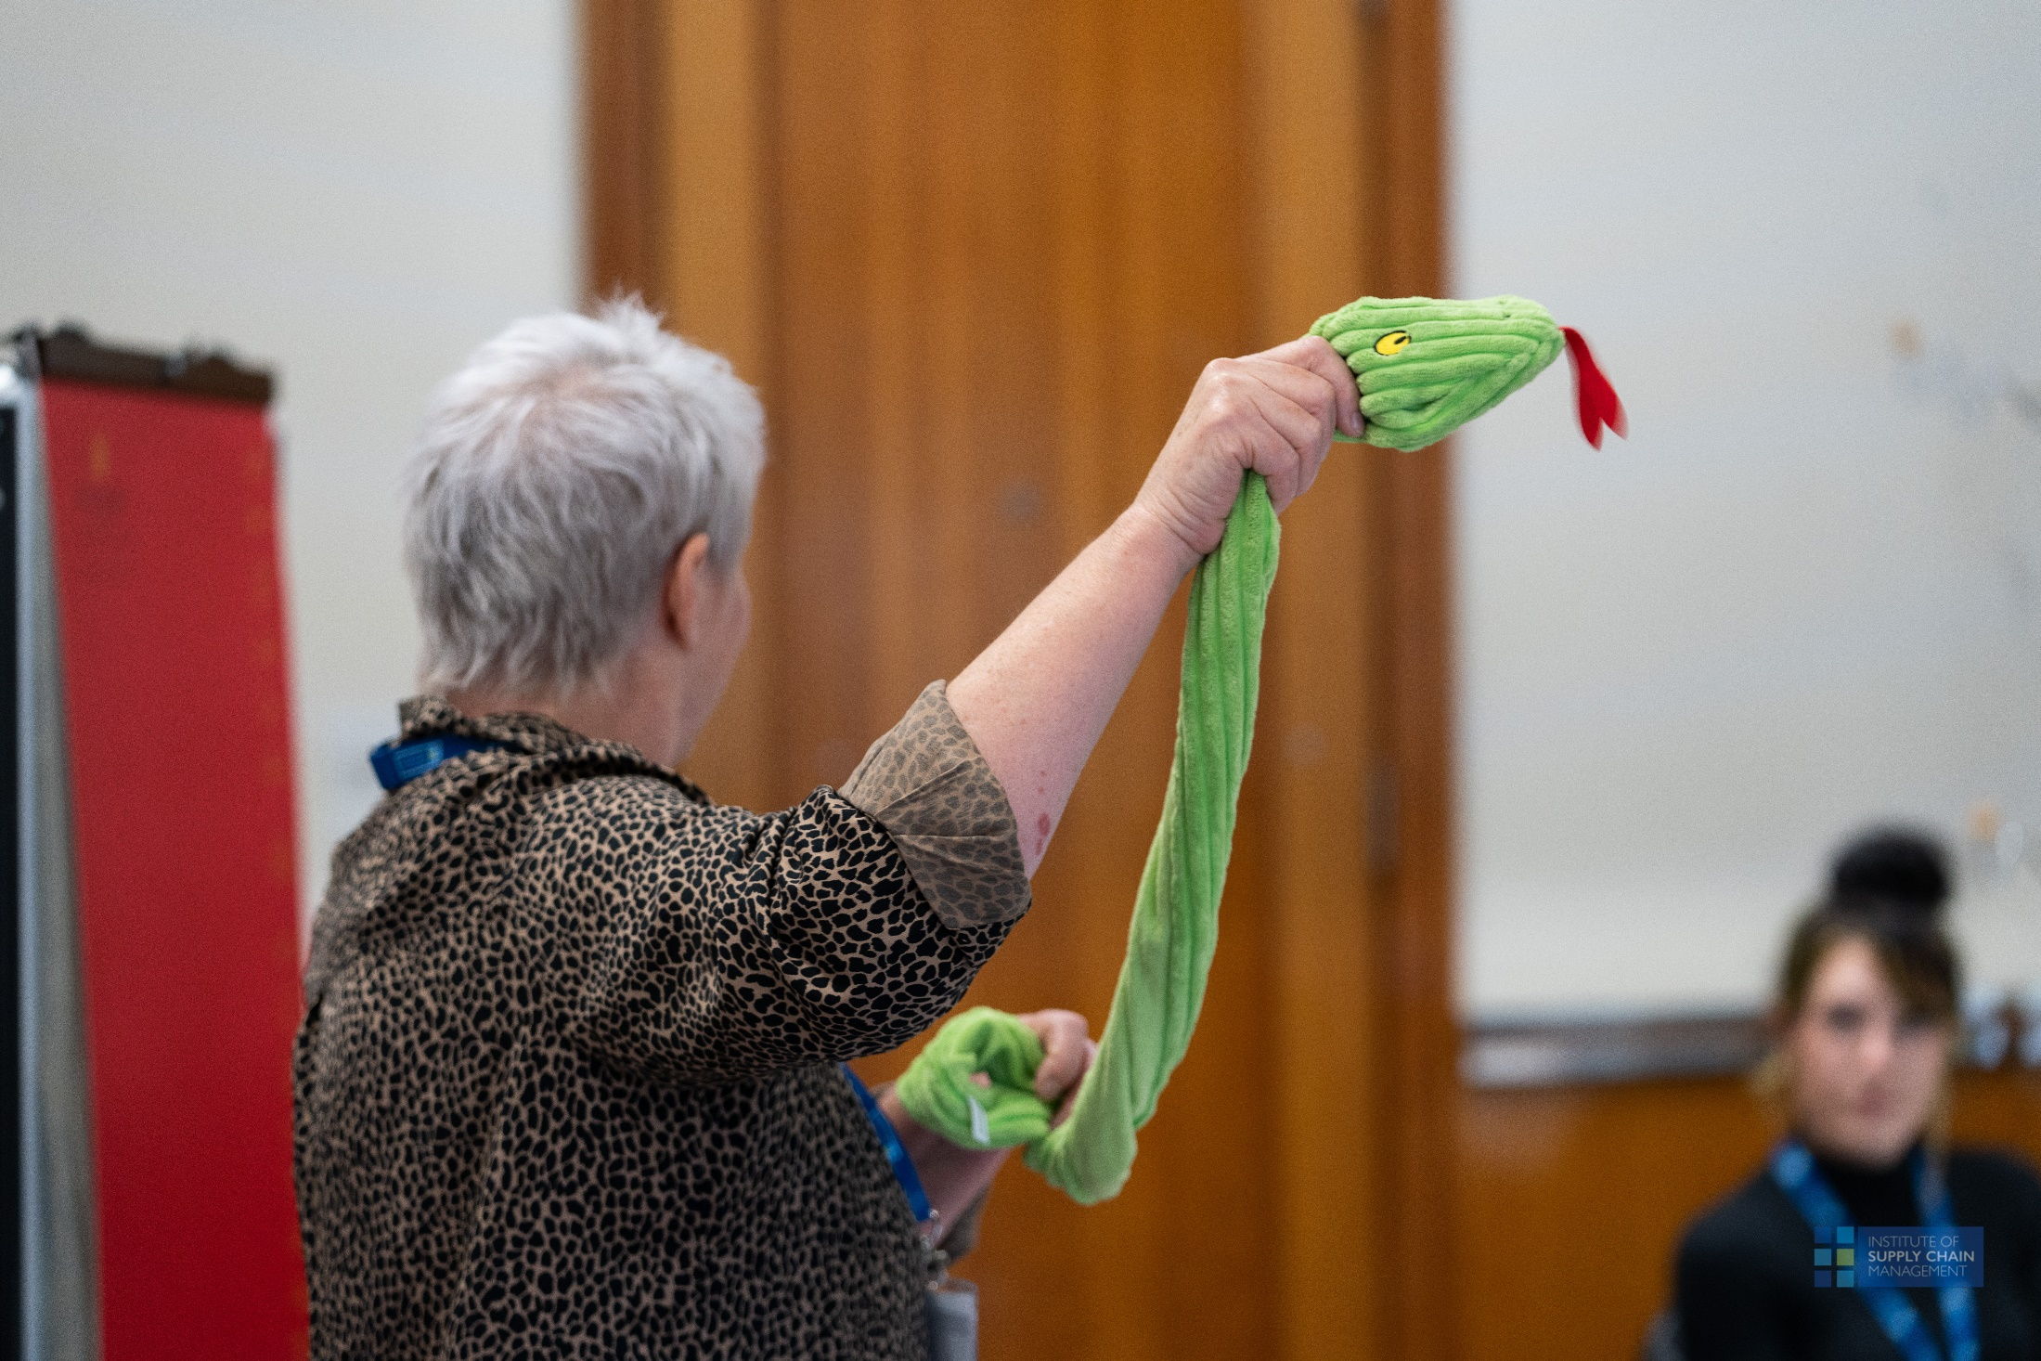

Slide 4
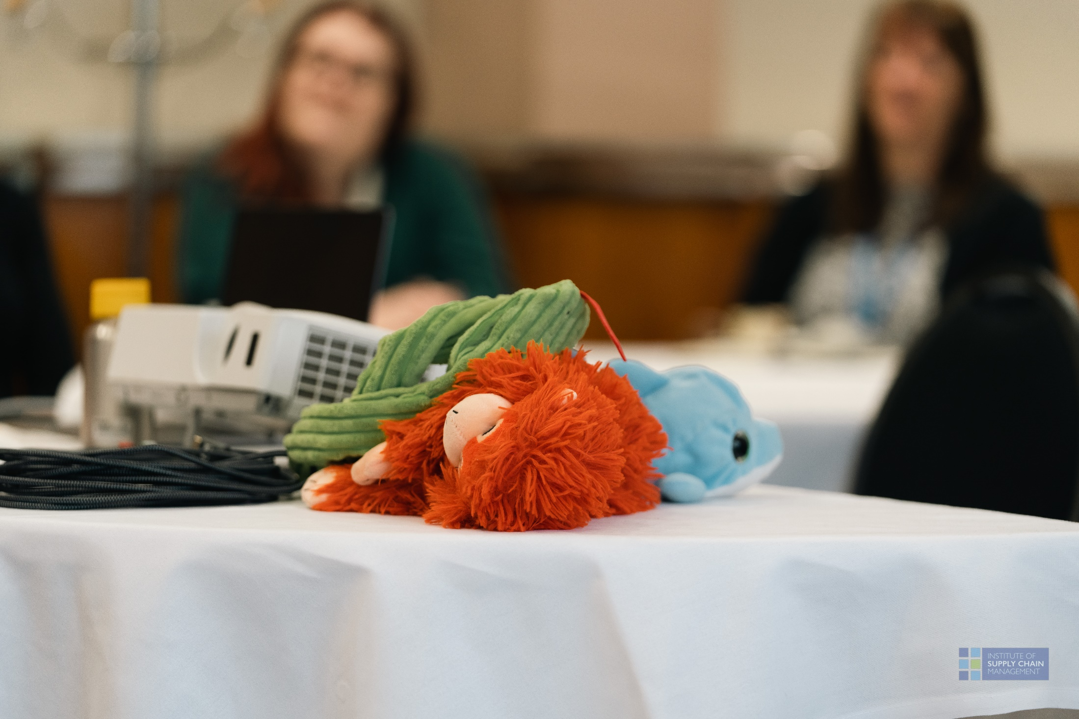

Slide 5
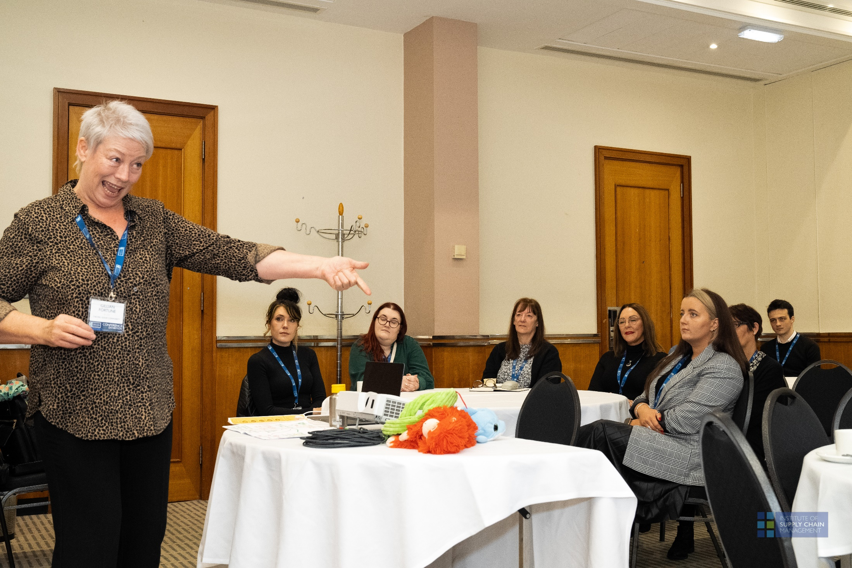

Slide 6
