Slide 1



IoSCM
Conference
& Exhibition
WORKSHOP
14:30 – 15:00
Armed Forces Covenant and ERS Schemes
Learn how the Armed Forces Covenant and Employer Recognition Scheme can Help your Organisation.
The AFC represents a promise by the nation that those who serve or have served, and their families, are treated fairly.
The Employer Recognition Scheme (ERS) encourages employers to support defence and inspire others to do the same.
Darren Rhodes
BSc (HONS)
Regional Employer Engagement Director, NE RFCA (MOD)
Copthorne Hotel
Newcastle
20th October 2022

Slide 2

The Armed Forces Covenant
&
Employer Recognition Scheme (ERS)

Slide 3
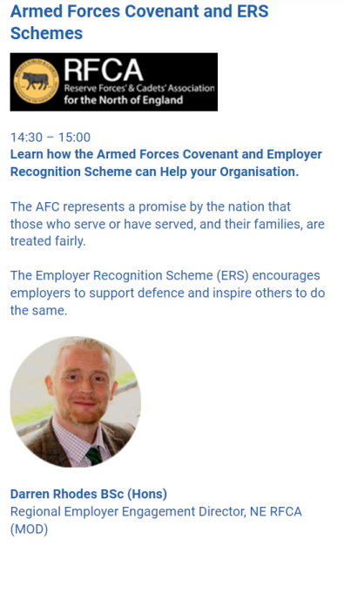

Slide 4

What is the Armed Forces Covenant?
To those who proudly protect our nation, who do so with honour, courage, and commitment, the Armed Forces Covenant is the nation’s commitment to you.
It is a pledge that together we acknowledge and understand that those who serve or who have served in the armed forces, and their families, should be treated with fairness and respect in the communities, economy and society they serve with their lives.

Slide 5
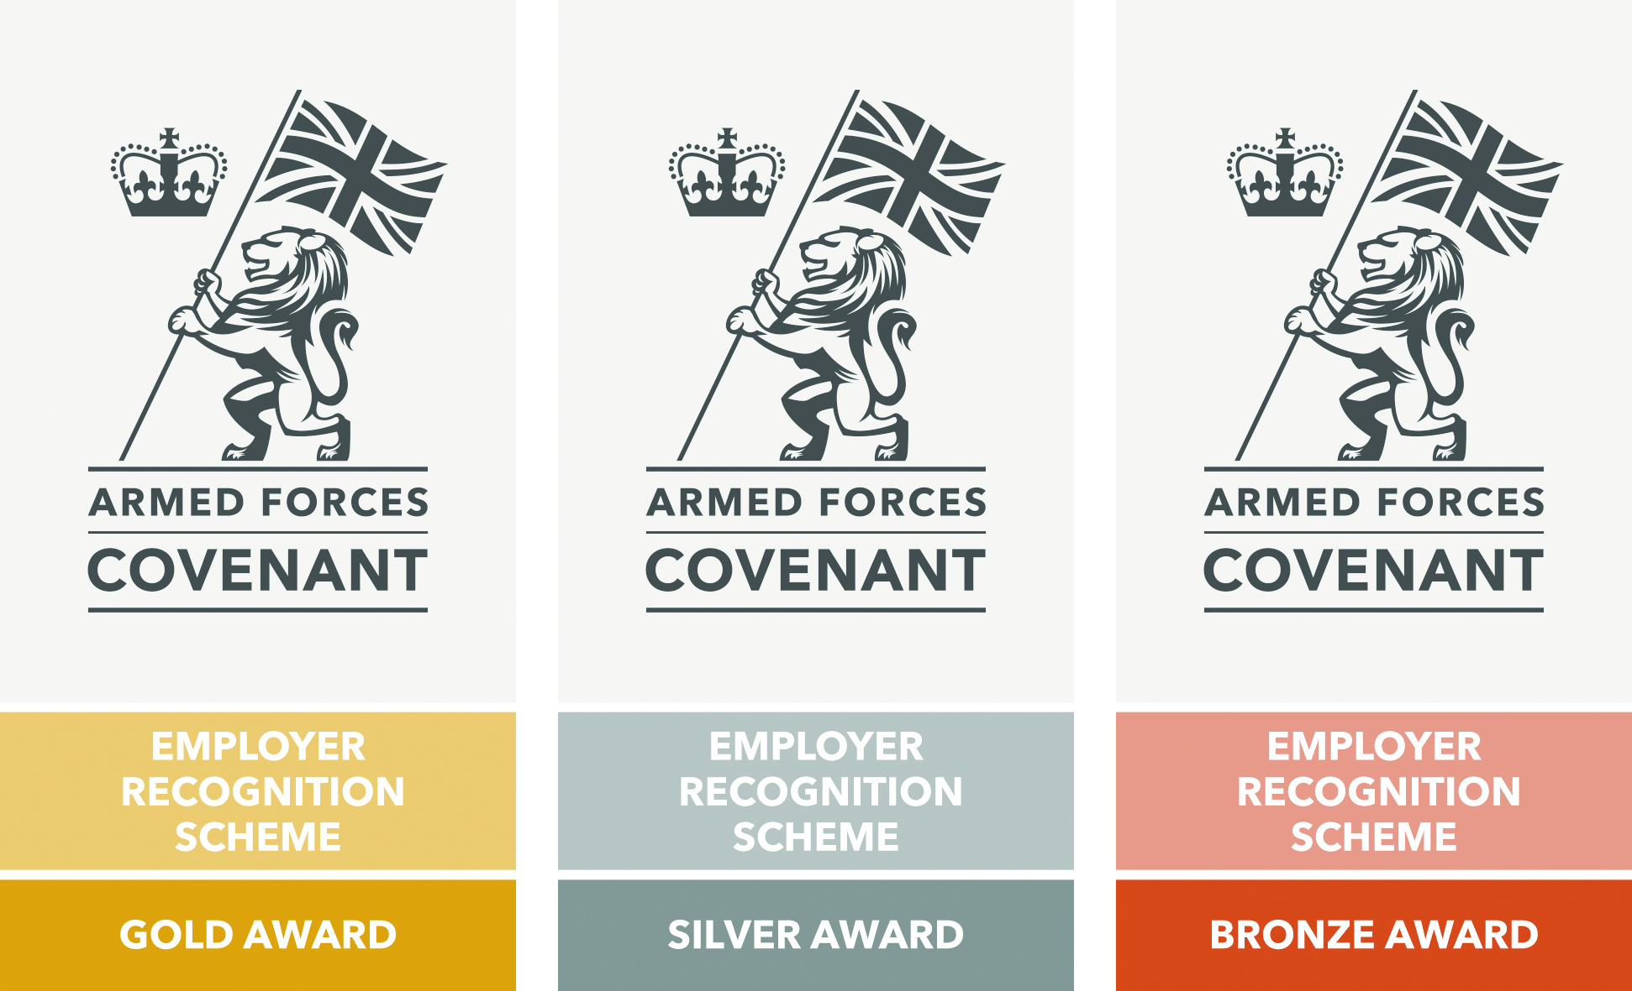
What is the Employer Recognition Scheme?
The Employer Recognition Scheme encourages employers to support Defence and inspire others to do the same.
The scheme encompasses Bronze, Silver and Gold awards for employer organisations that pledge, demonstrate or advocate support to Defence and the armed forces community, and align their values with the Armed Forces Covenant.

