Slide 1
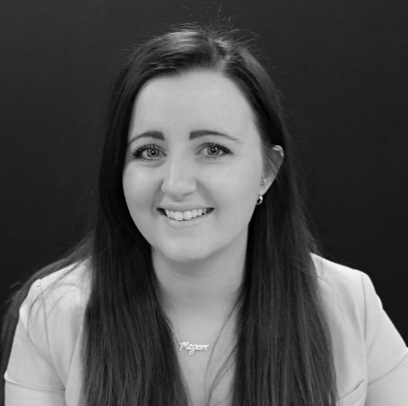
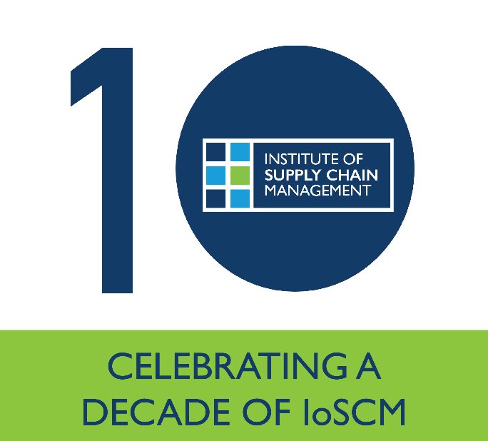
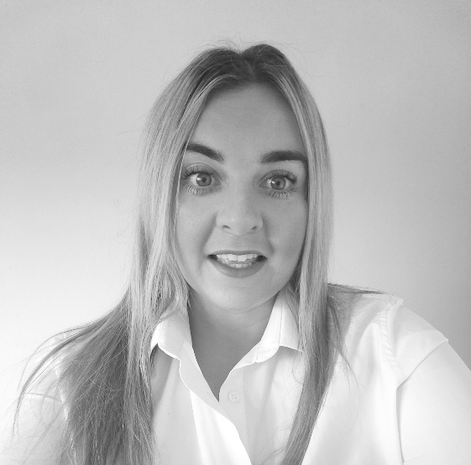

IoSCM
Conference
& Exhibition
WORKSHOP
13:30 – 14:00
Discover more about Corporate and Individual Membership
Visit the Members HUB, find the most beneficial membership level for you, and receive guidance on your application.
Megan Slater
IoSCM, Head of Sales & Business Development
Copthorne Hotel
Newcastle
20th October 2022
Emily Archer
IoSCM, Membership Advisor

Slide 2

Discover more about Corporate and Individual Membership

Slide 3
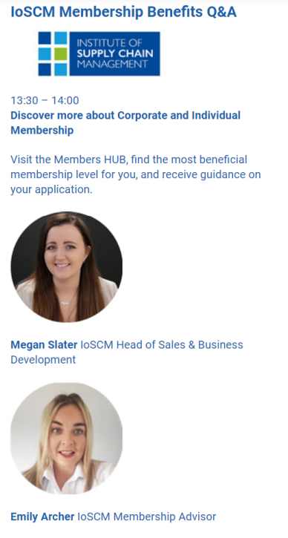

Slide 4
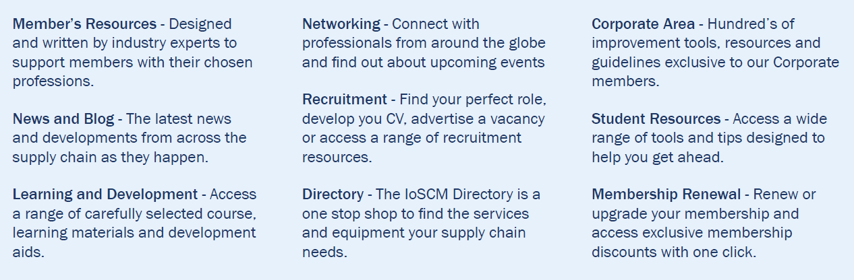
Benefits of IoSCM Membership
Becoming a member of the Institute of Supply Chain Management provides you with access to a range of services, all designed to enhance understanding and efficiencies in each sector of the Supply Chain

Slide 5
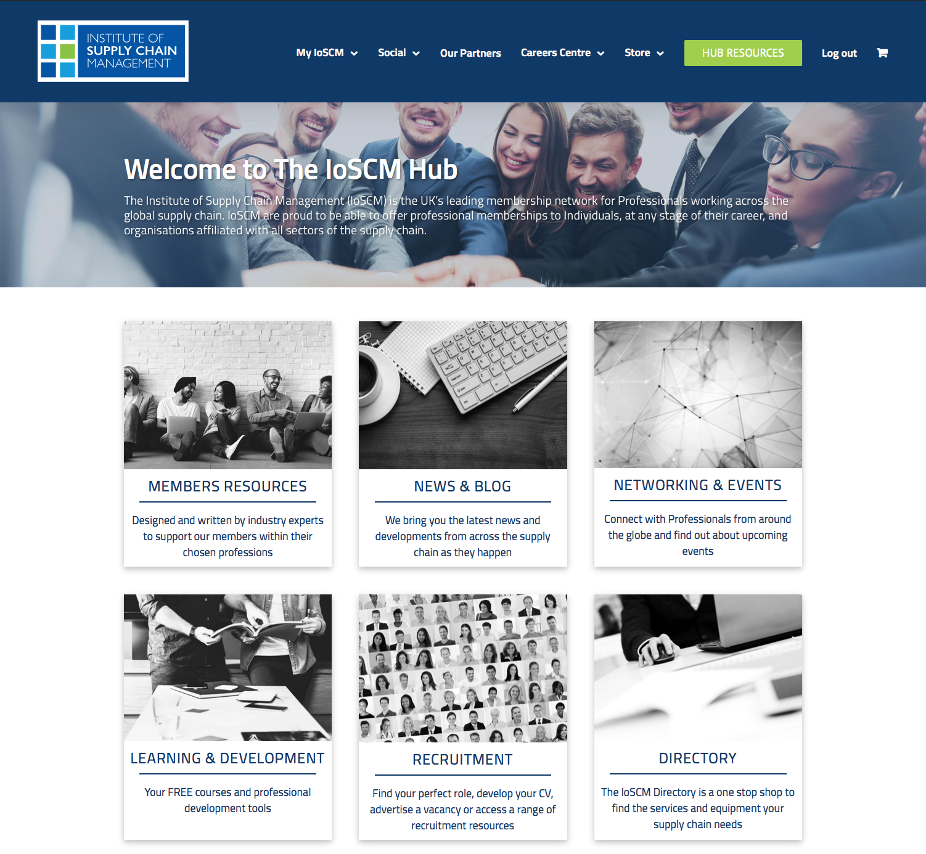
The IoSCM Hub

Slide 6
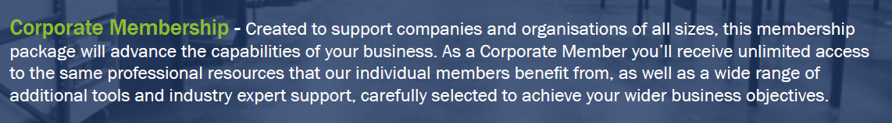
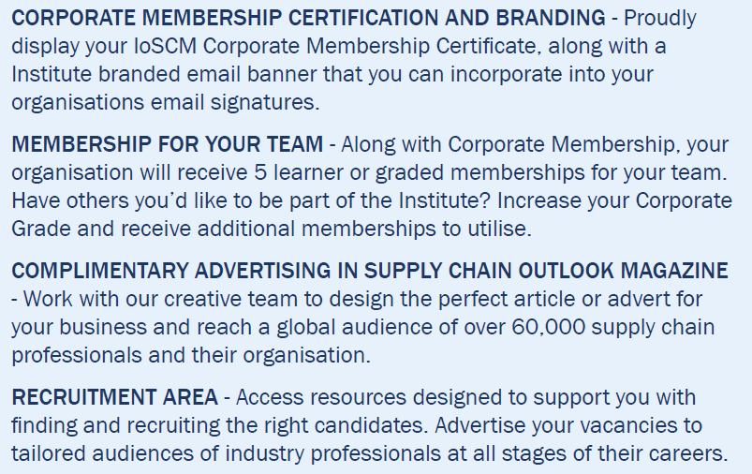
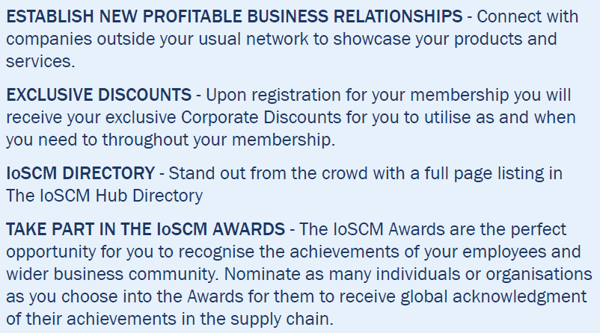
Corporate Membership

Slide 7
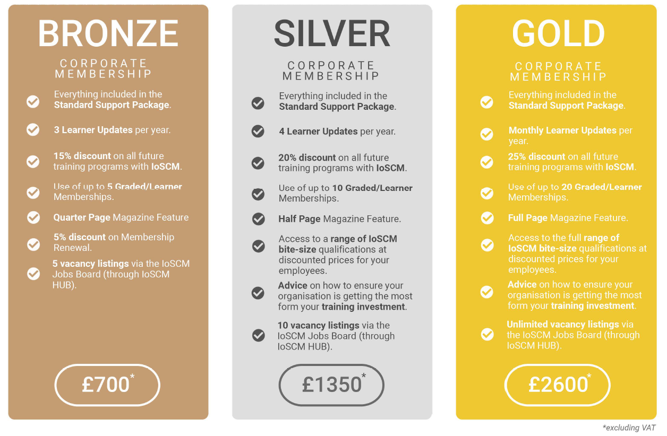
Corporate Membership

Slide 8
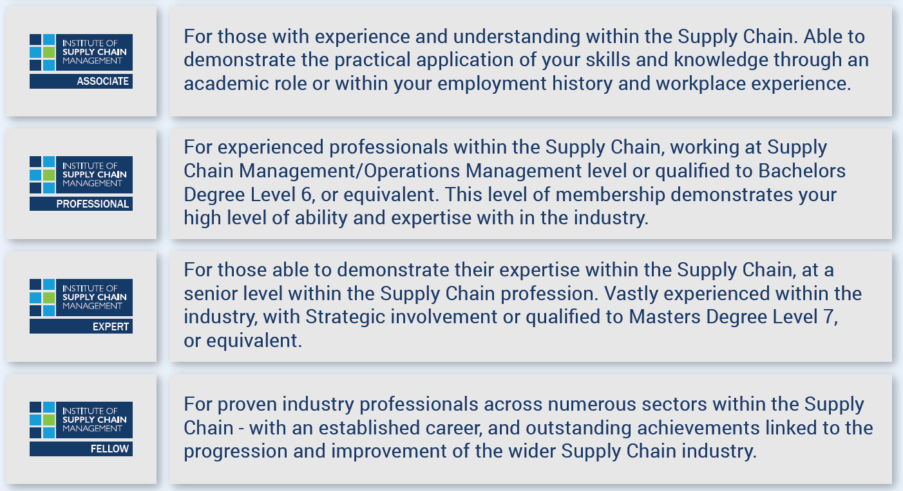
Graded Membership (for Individuals)

