Slide 1
Leading Through Uncertainty
Lieutenant Colonel Andy Black

Slide 2
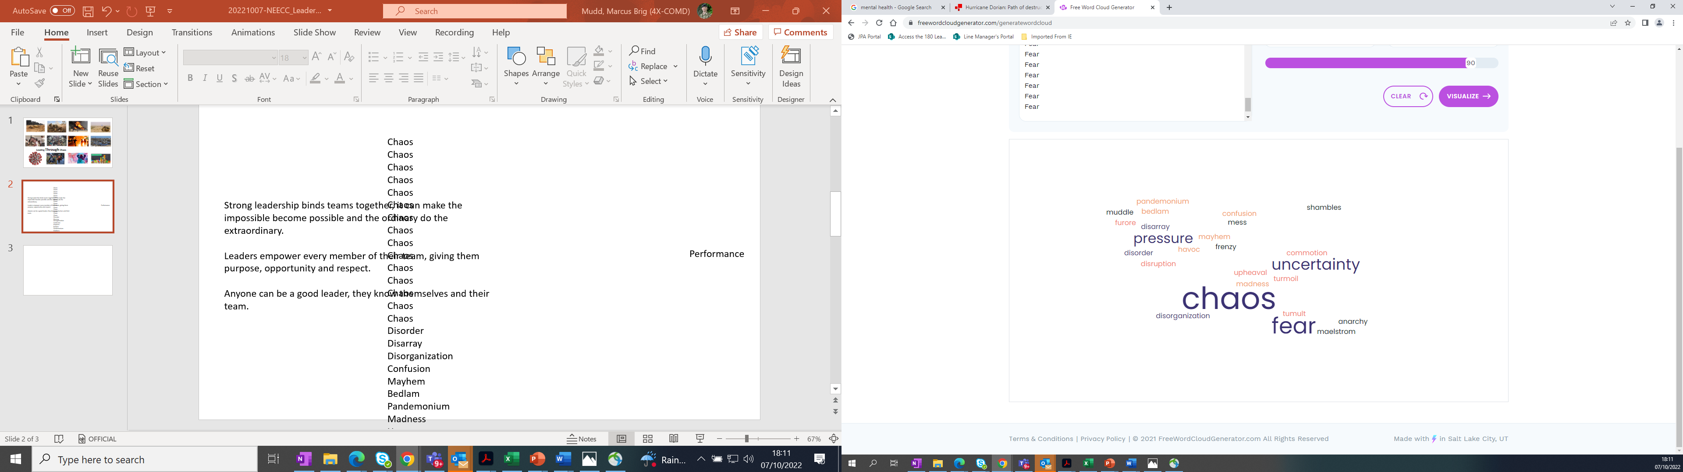
Chaos, uncertainty and fear undermine our ability to operate efficiently – good leadership cuts through it

Slide 3
Purpose:
Planning & Preparation
Task
Team
Individual
People:
Understood, Mentored & Respected
Empowerment:
Trusted, Motivated & Inspired
John Adair’ Action-Centred Leadership Model
Leaders empower every member of their team, giving them purpose, opportunity and respect

Slide 4
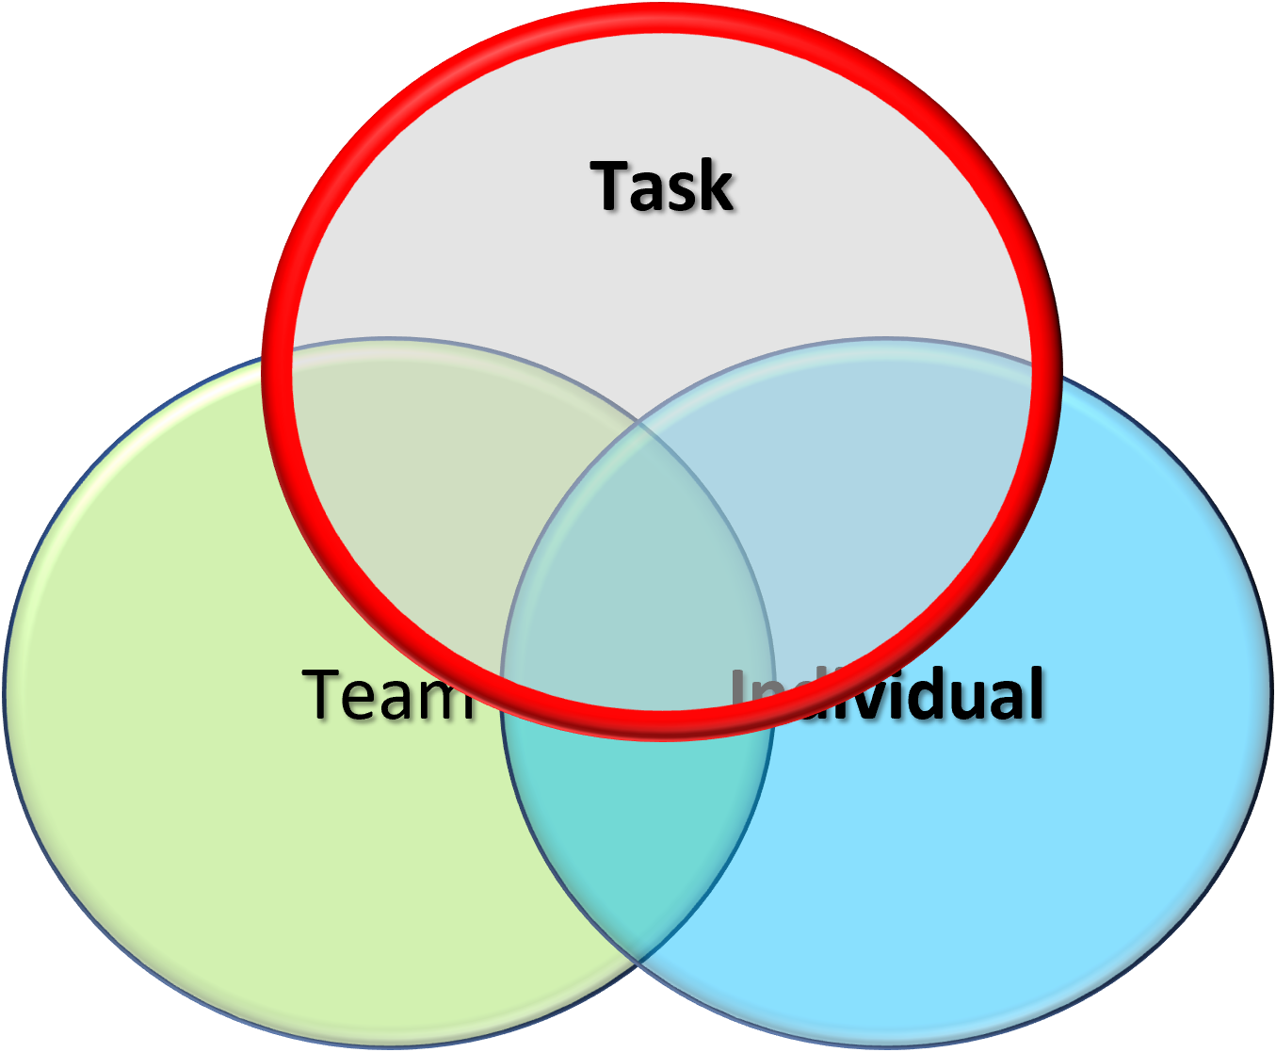
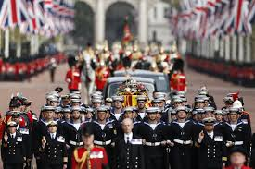
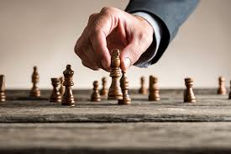


Purpose:
Planning & Preparation
Methodical Planning
War Game
Practice
Precision

Slide 5
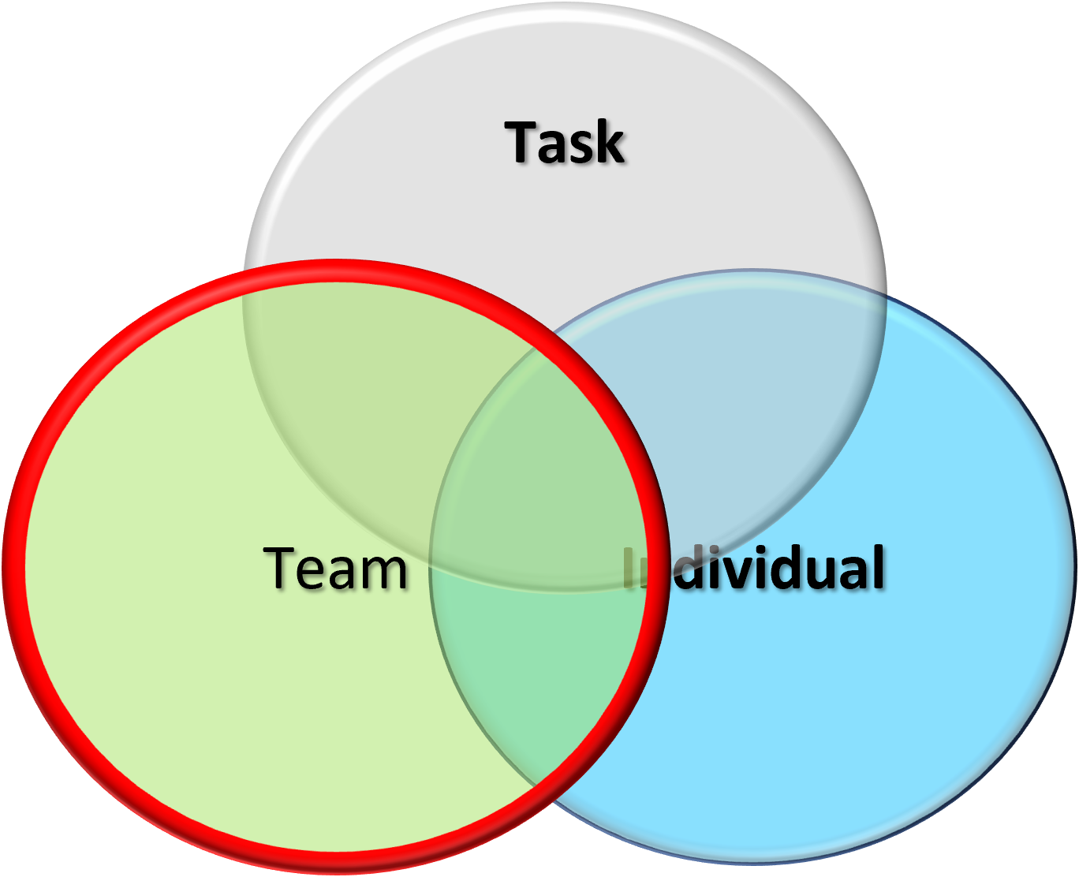
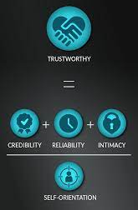
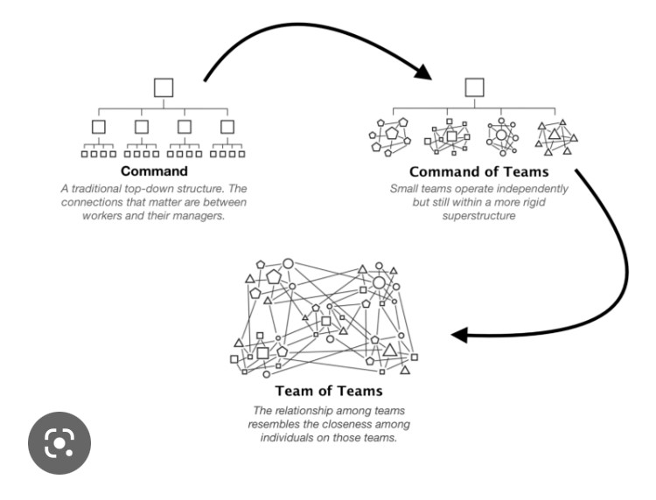

Empowerment:
Trusted, Motivated & Inspired
Strong leadership binds teams together, it can make the impossible become possible and the ordinary do the extraordinary.

Slide 6

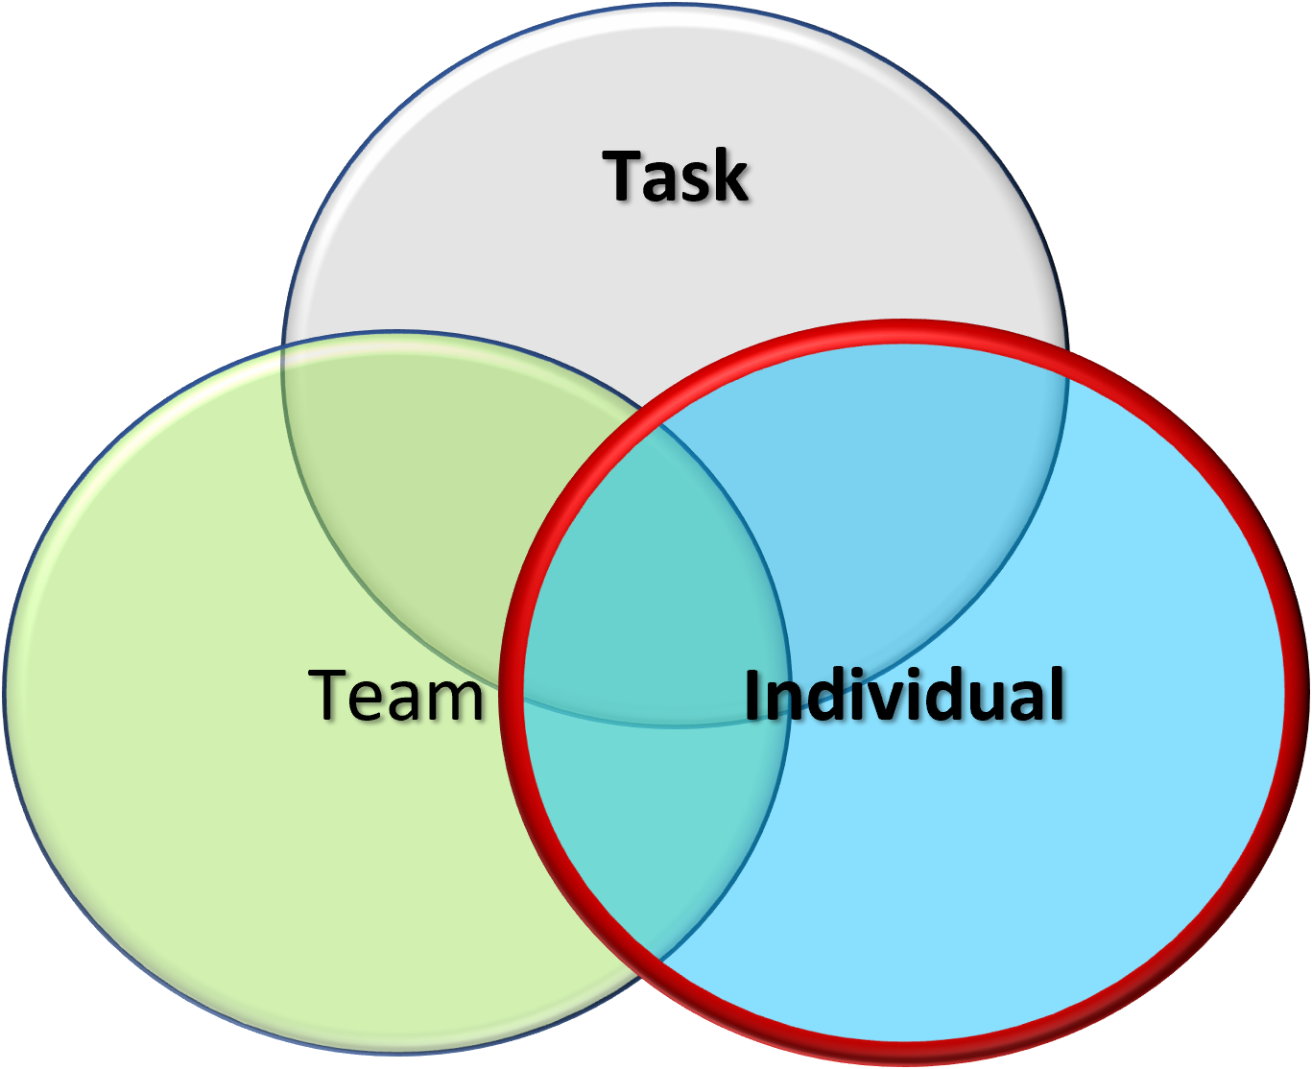


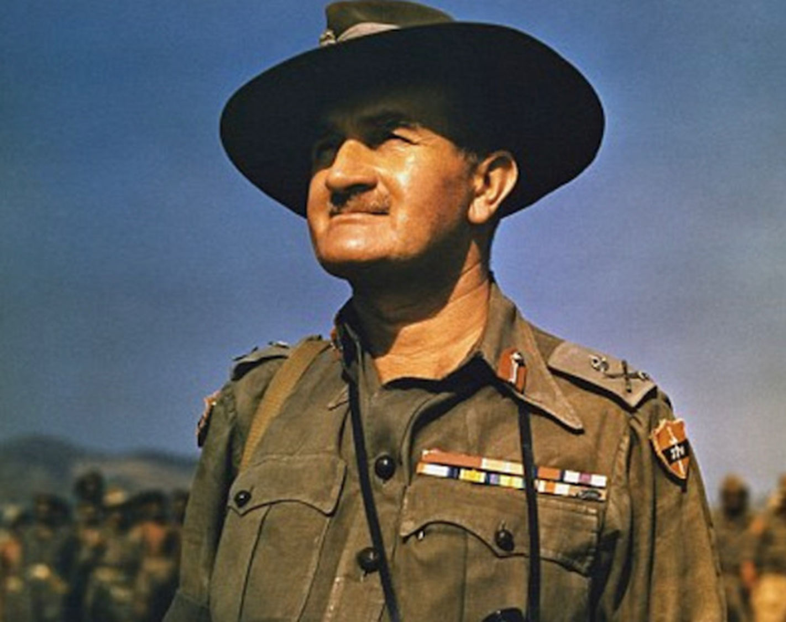


People:
Understood, Mentored & Respected
Anyone can be a good leader, but they have to know themselves and their team

Slide 7
Good Leaders:
Task
Think logically in a crisis
Team
Individual
Are calm under pressure
Offer insight and inspiration
Set a clear vision and goals
Build teams based on trust and respect
Invest time and energy in their people
Anyone can be a good leader

Slide 8


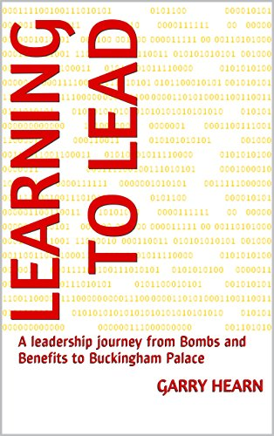

Leaders are Readers – prepared to listen and learn from others

Slide 9
Questions
Leading Through Uncertainty

